Slide 1

Collaborations Pharmaceuticals Inc.
Fantastic Molecules and Where to Find Them
MB 585 SPRG 2024
30-April-2024
Presenters: Harrison Marisiddaiah, Mikayla Richards, Maryam Raza

Slide 2

Table of Contents
Project Background
Market Analysis
Epidemiological Analysis
Potential Partnerships
Competition
Recommendations
01
02
03
04
05
06

Slide 3

01
Project Background

Slide 4



Collaborations Pharmaceuticals, Inc.
Sean Ekins, CEO
Founded CPI in 2016
Aaron Oliver, Business Dev. coordinator/ Mentor
Located in Raleigh NC
16.7 M in non-dilutive funding

Slide 5
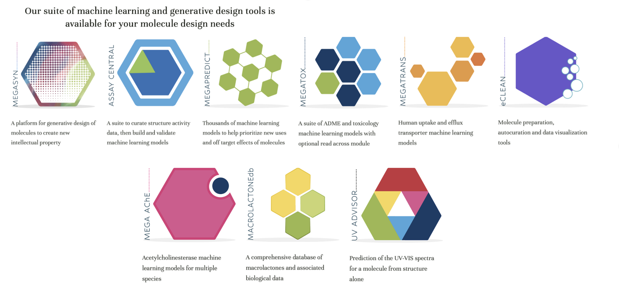
CPI Software Suite

Slide 6
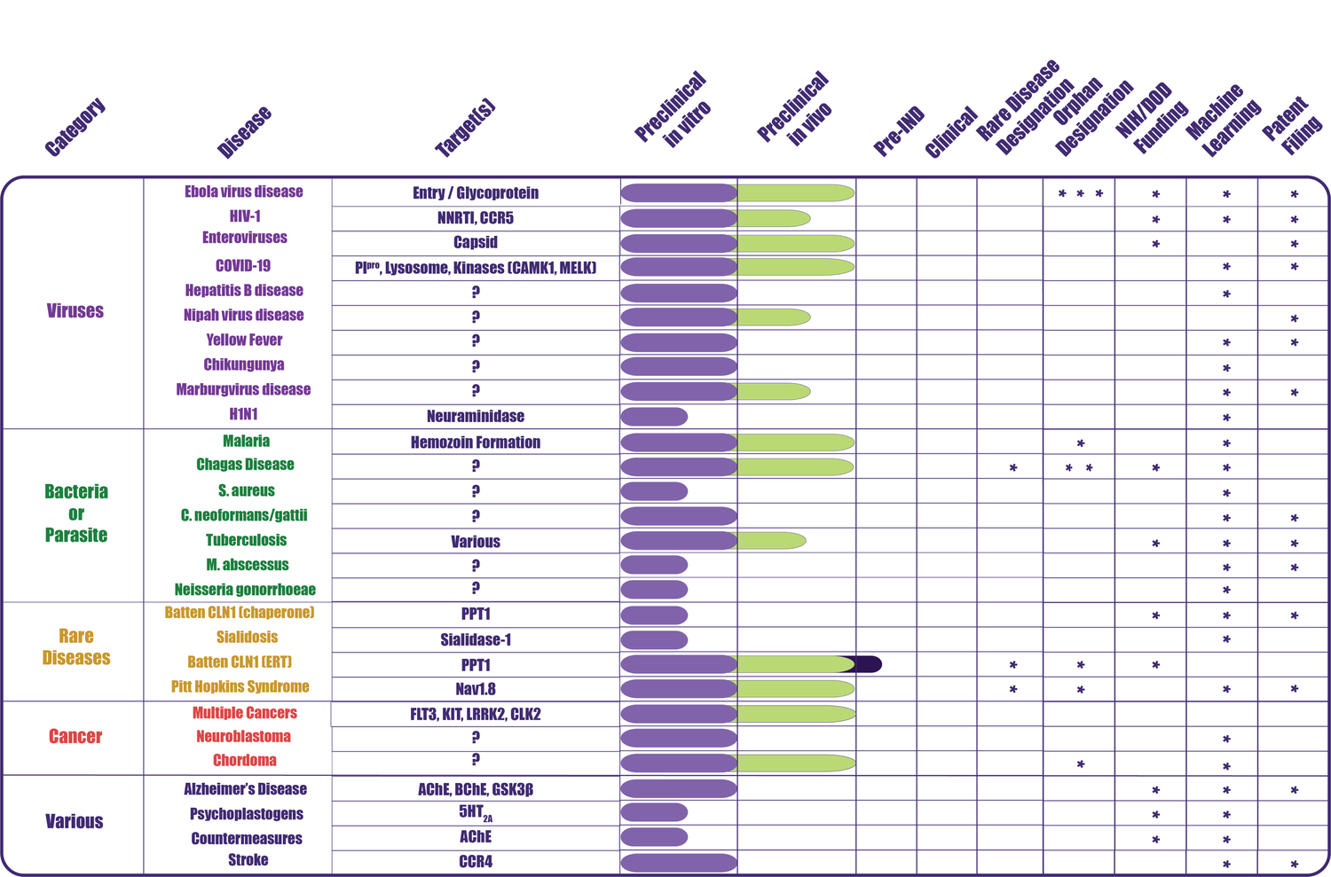
Product Pipeline

Slide 7
Project Background
Scope
Drivers
-Identify and secure external partners to license assets in CPI’s pipeline
-Market potential analysis for drug candidates
-Small company
-Drug discovery and clinical pipeline processes are costly
-Retain ownership over assets
-Expand entry into market

Slide 8

Project Timeline
Final Deliverables 4/30
Mid-Project Update 3/21
Kick-Off 2/14
VOS Outreach & Market Research 4/12
Preliminary Partner Review 3/15

Slide 9
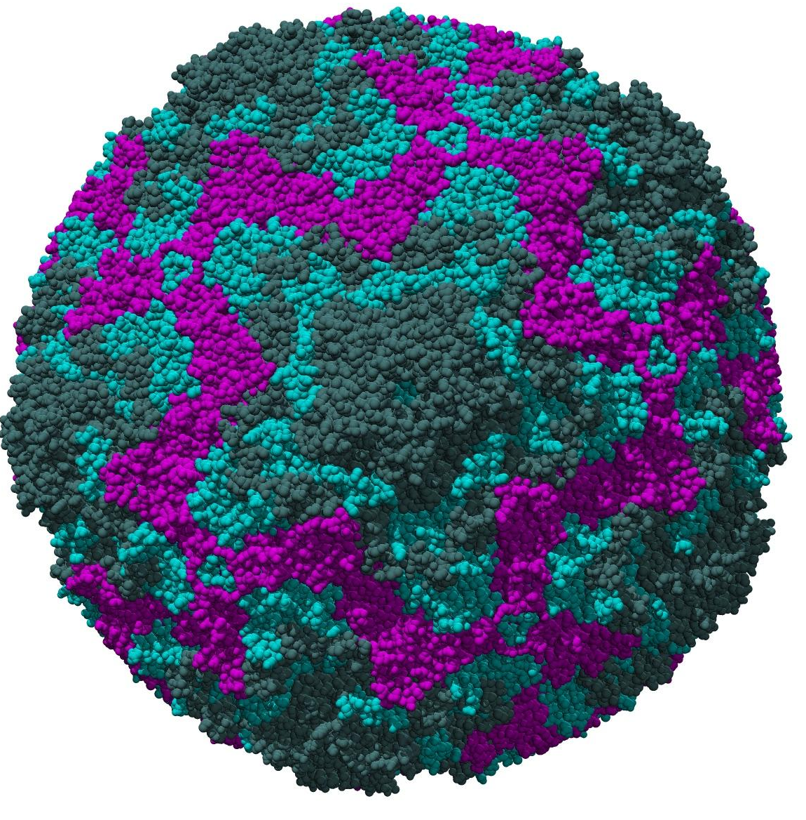
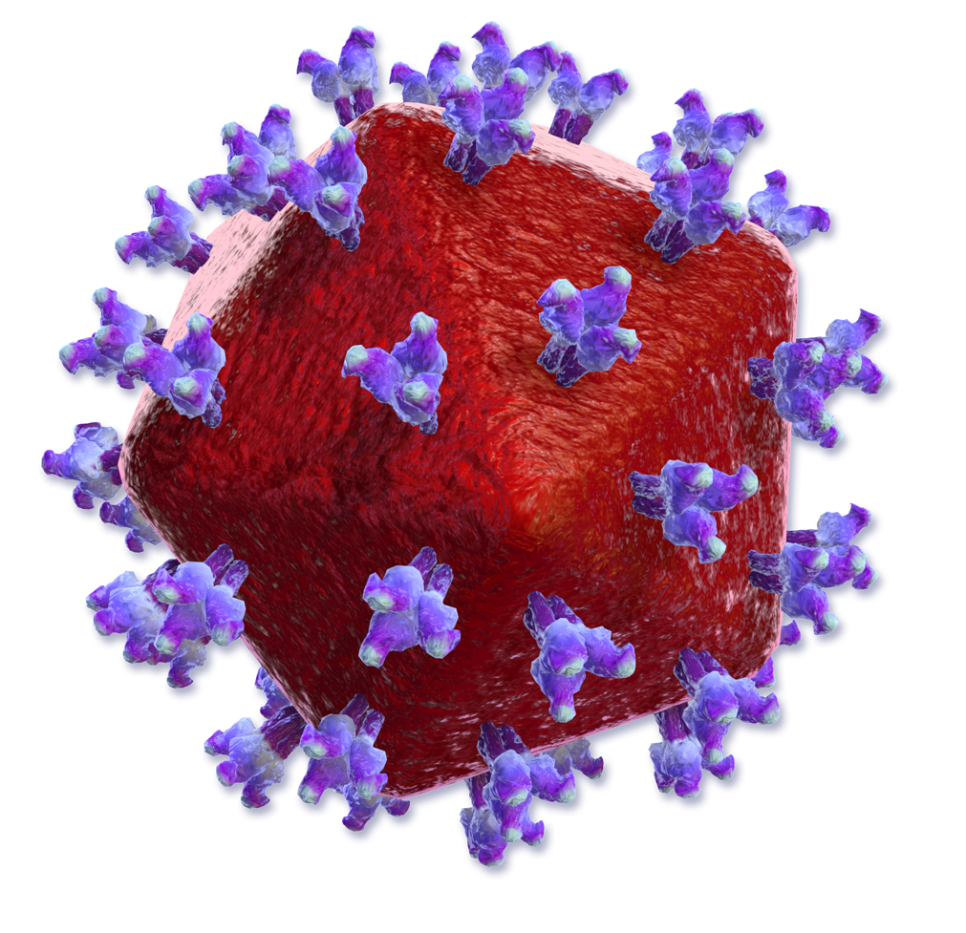
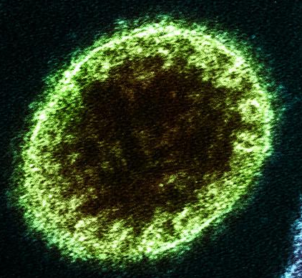
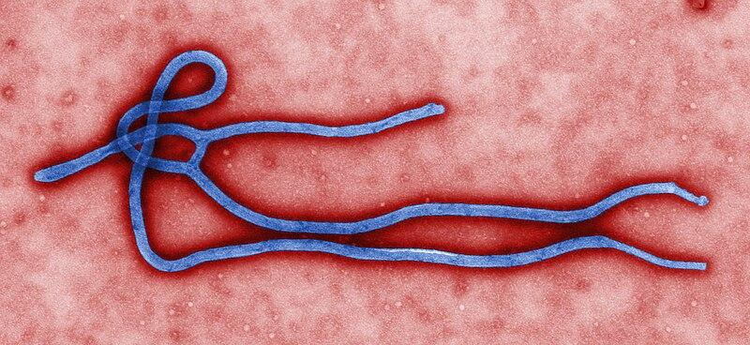
Candidates for Collaboration
Enterovirus
Ebola
HIV
Nipah

Slide 10
02
Market Analysis

Slide 11
68.3B
106.3B
8%
Infectious Disease Markets Overview
Market Value
Projected (2026)
CAGR
BCC Publishing 2021

Slide 12
Market Analysis
Drivers
Restraints
Better access to treatment and diagnosis
Increased research into novel mechanisms
New vaccine approvals
Self-testing and collaboration
Resistance to current standards of therapy
Prohibitive cost of treatments
Accessibility in high need regions

Slide 13
Key Findings
The North American and European Markets hold the largest market share
Africa has the highest incidence of HIV but only comprises 7% of the total global Market share
Growth potential for hemorrhagic fevers (ie. Ebola) is dependent on severity of outbreaks
HIV diagnostics and treatments are high value markets
Notes:
Figure describing Market values and growth

Slide 14
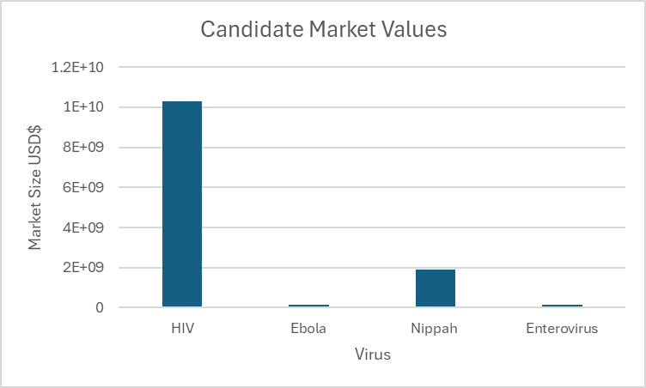
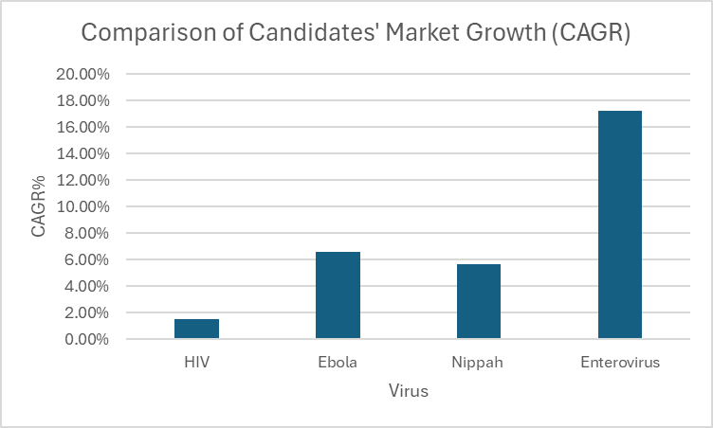
Comparison of Candidates

Slide 15
03
Epidemiological Analyses

Slide 16
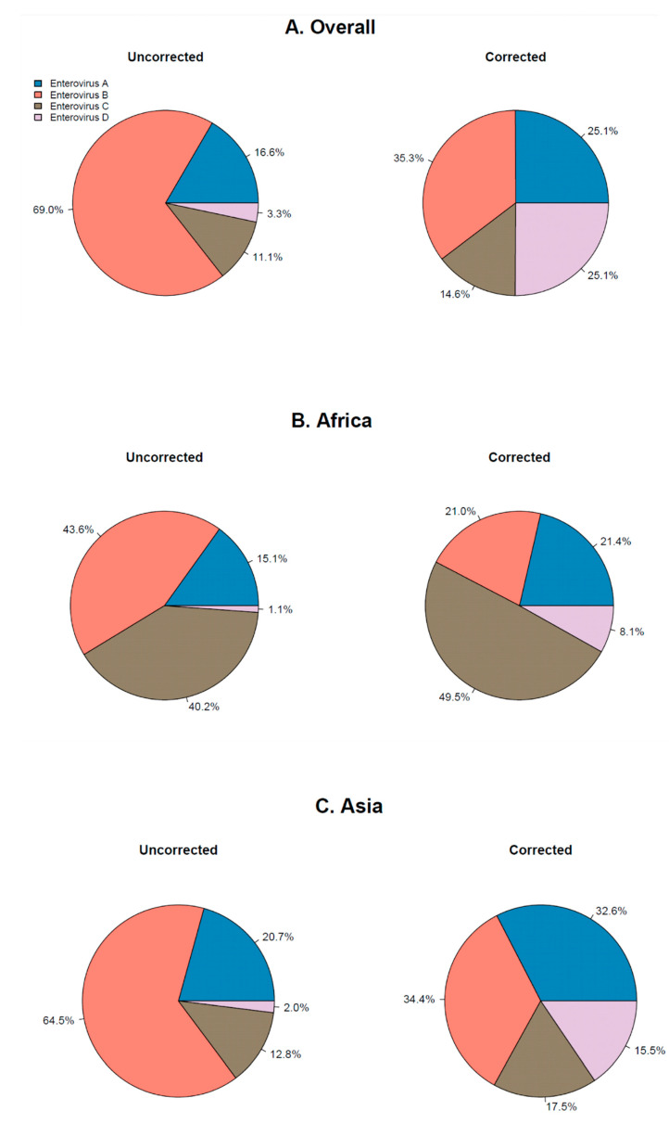
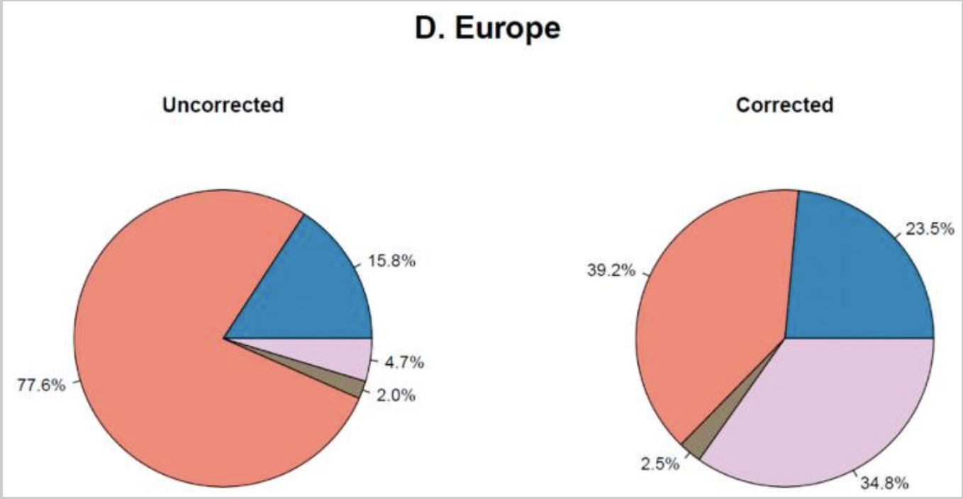
Enterovirus
Studies conducted from 2002-2019 and data corrected in 2021.
Notes:
Enterovirus is a genus of RNA viruses that cause diseases that impact the brain, heart, respiratory system, and potentially the nervous system
outbreak in 2014 (2000 people)
150 studies to make pie charts of 4 strains (82 types)
Enterovirus B overall, C in Africa
Amino acid mutations in epitopes of viral capsid proteins
Capsid targeted antivirals
Fail in clinical trials
Disease must run course

Slide 17
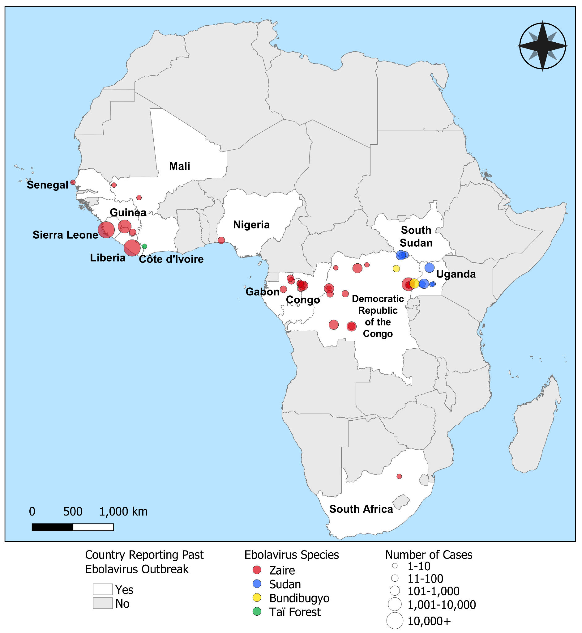
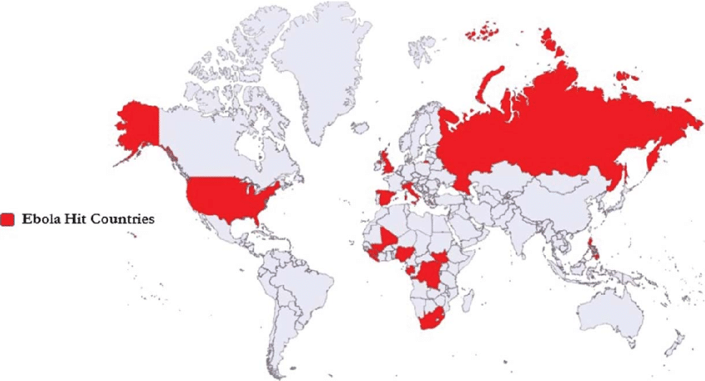
Ebola
Countries that have had Ebola outbreaks since 1976
Outbreaks and species of virus since 1976 (CDC)
Notes:
Ebola moderately transmissible disease in Central and West Africa, but outbreaks worldwide
Spread through contact, handling bushmeat, funerals
2014-2016 outbreak in West Africa 4000/14000 died
During this, vaccine research underwent trials
Merck vaccine FDA approved, but not commercial (long-term effects unknown)
Two monoclonal antibody based drugs improve survival rates, but costly and inaccessible

Slide 18
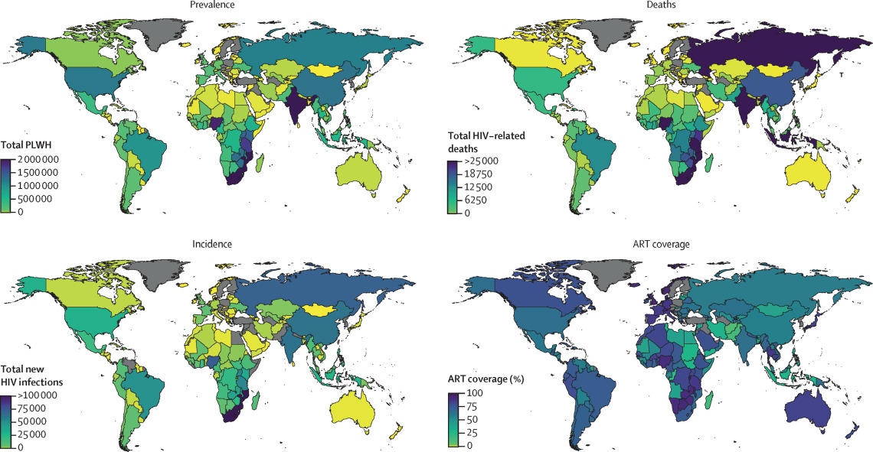
HIV
Report Published: Nov 2023

Slide 19
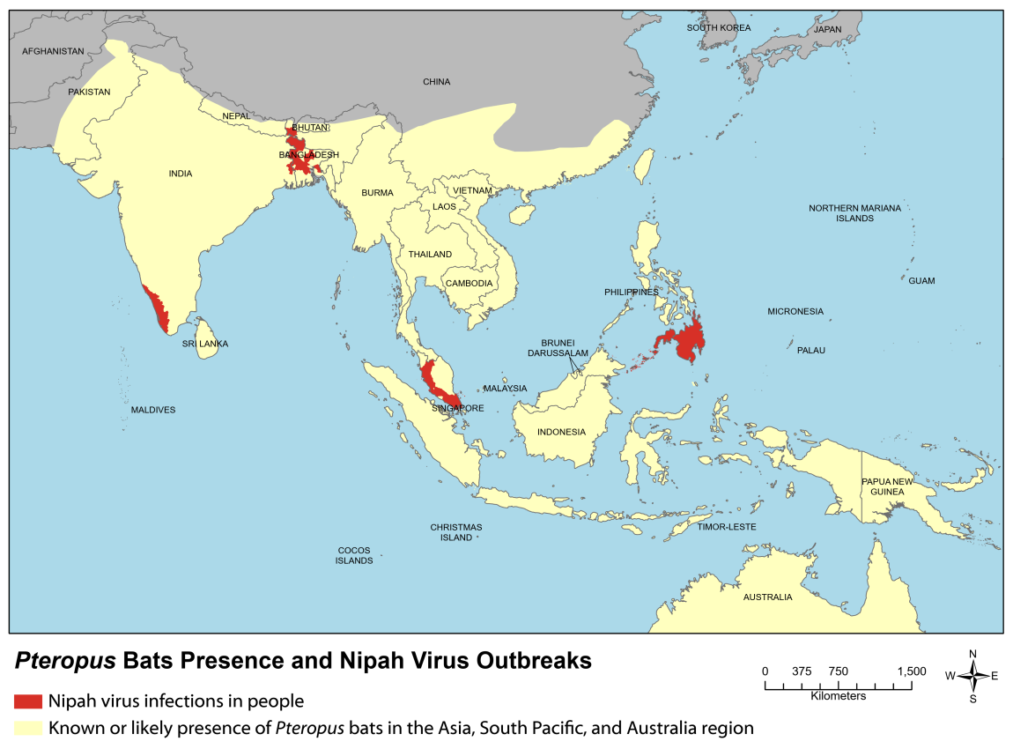
Nipah Virus
Last reviewed: February 2, 2023

Slide 20
04
Potential Partnerships

Slide 21
Evaluation Criteria
DISEASES
TARGETS
SMALL MOLECULE
AI
Ebola, HIV, Nipah, Enterovirus
Glycoprotein (ebola), NNRTI/CCR5 (HIV), Nipah, Capsid (Enterovirus)
Therapeutic composition
Machine Learning, Data Learning

Slide 22
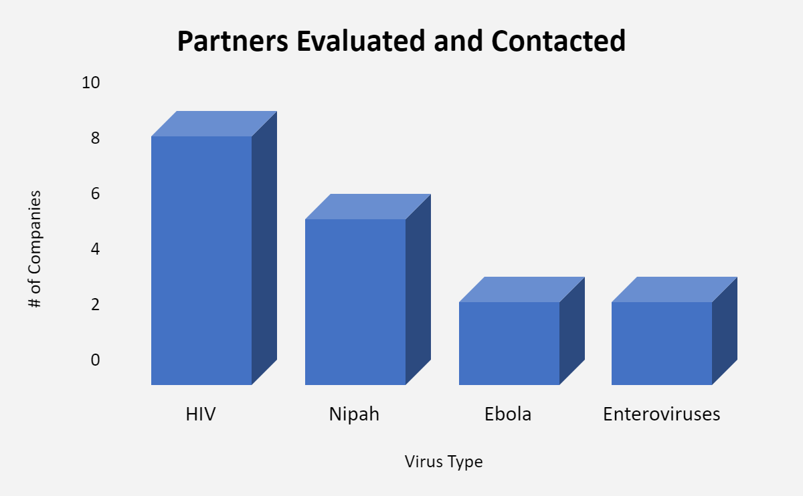
Outreach & Outcome
Outreach via email and phone calls to business development departments
Evaluated total of 22 companies, contacted 20
Responses = 1 (Merck, HIV)

Slide 23
Notable Mentions
HIV
Well-established company that can bring financial knowledge & expertise to support clinical pipeline processes
Multiple pre-existing partnerships in the industry
Only company that responded
Ebola
High focus candidate in company pipeline
Researching on Ebola small molecules and smallpox only
Have existing collaborations and potential to be open to collaboration
Merck
Ridgeback Biotherapeutics
Nipah
High focus candidate in company pipeline
Nipah therapeutic is furthest in development phases (pre-clinical)
Potential to be open to collaboration
Enterovirus
Existing partners with CRO/CDMO
Interest in drug development through AI
Cayman Chemicals
Public Health Vaccines LLC

Slide 24
05
Competition

Slide 25
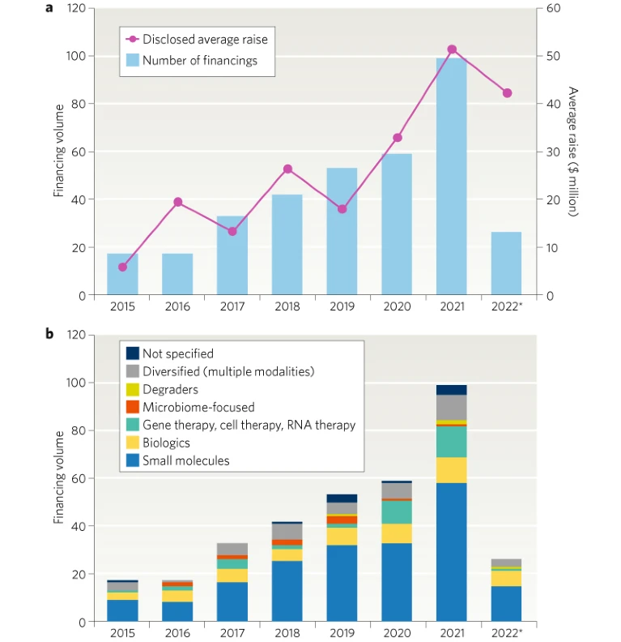
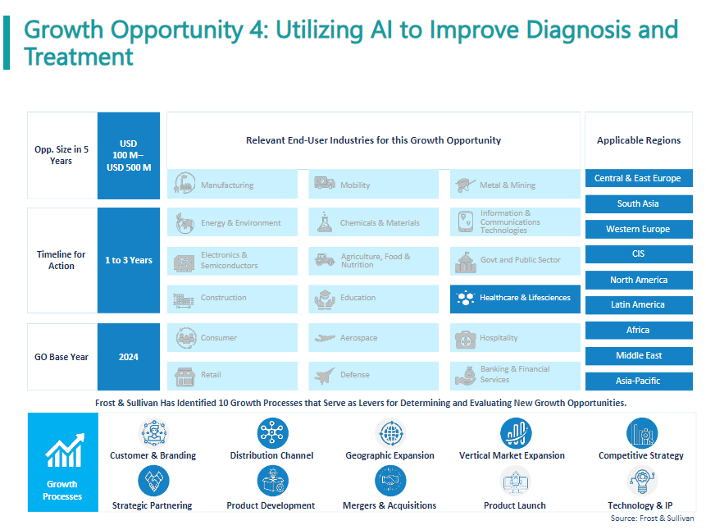
Significance
2022 financings for companies engaged in AI/ML-enabled drug discovery and development. a | Venture-capital-backed private financings with disclosed raises for companies from seed stage to series D. b | Financing by disclosed modality when specified; biologics includes peptides, vaccines, antibodies, bispecific molecules and medium-sized macrocycles.
Published: 2024
Notes:
Source: Frost & Sullivan.
(2024, March 01). Global Orphan Drug Growth Opportunities. https://store-frost-com.prox.lib.ncsu.edu/wip/PFA6-01-00-00-00
Kirkpatrick, P. (2022). Artificial intelligence makes a splash in small-molecule drug discovery. Biopharma Dealmakers. https://doi.org/10.1038/d43747-022-00104-7
AI in small molecule drug discovery | Elsevier. (n.d.). Www.Elsevier.Com. Retrieved April 25, 2024, from https://www.elsevier.com/industry/ai-in-small-molecule-drug-discovery

Slide 26






Competitors
Machine learning exposome sequencing platform for precision diagnostics of rare conditions
Predictive analytics to streamline drug discovery development
ATLAS: Physics-based drug discovery platform for critical diseases
Plant-based drug discovery; explore resources for therapeutic value using ML and mass spectrometry
Physics-driven drug design platform simulating advanced molecular dynamics
ML-platform to accelerate biologics drug discovery
Notes:
Source: Frost & Sullivan. (2024, February 09). Recent Advances in Drug Design, Discovery, and Development.. https://member-frost-com.prox.lib.ncsu.edu/login?reportID=D759-00-41-00-00
Seismic: ML with translational immunology, protein engineering, and structural biology into the biologic drug discovery process. The platform enables parallelized multi-property optimization, including protein invisibilization for the accelerated generation of novel biologics.
Source: Frost & Sullivan. (2024, January 19). Technology Innovations Across Drug Discovery, Precision Medicine, Pain Management and Regenerative Medicine. https://member-frost-com.prox.lib.ncsu.edu/login?reportID=D759-00-40-00-00

Slide 27
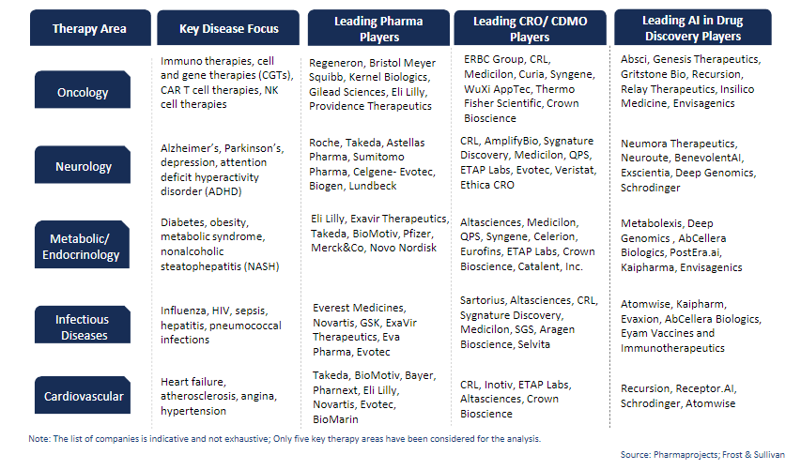
Competitors
Notes:
Source: Frost & Sullivan. (2024, February 20). Growth Opportunities in Drug Discovery and Early Development Outsourcing Services. https://store-frost-com.prox.lib.ncsu.edu/wip/PFA5-01-00-00-00

Slide 28
06
Recommendations
You can enter a subtitle here if you need it

Slide 29
Recommendations
Partners
Market Potential
Impact
Competition
Merck → HIV
Ridgeback Biotherapeutics → Ebola
Public Health Vaccines → Nipah Virus
Cayman Chemicals → Enterovirus
HIV > Enterovirus > Ebola > Nipah
HIV & Enterovirus
Variety of competitors; ML platforms still in development

Slide 30
References
Anasir, M. I., Zarif, F., & Poh, C. L. (2021). Antivirals blocking entry of enteroviruses and therapeutic potential. Journal of biomedical science, 28(1), 10. https://doi.org/10.1186/s12929-021-00708-8
Brouwer, L., Moreni, G., Wolthers, K. C., & Pajkrt, D. (2021). World-Wide Prevalence and Genotype Distribution of Enteroviruses. Viruses, 13(3), 434. https://doi.org/10.3390/v13030434
Centers for Disease Control and Prevention. (2021, February 26). Ebola Disease: Treatment. Centers for Disease Control and Prevention. https://www.cdc.gov/vhf/ebola/treatment/index.html
Centers for Disease Control and Prevention. (2023a, February 2). Pteropus bats presence and Nipah virus outbreaks. Centers for Disease Control and Prevention. https://www.cdc.gov/vhf/nipah/outbreaks/distribution-map.html
Centers for Disease Control and Prevention. (2023b, September 15). Ebola vaccine: Information about ERVEBO®. Centers for Disease Control and Prevention. https://www.cdc.gov/vhf/ebola/clinicians/vaccine/index.html
Elsevier. (2020). Clinical and epidemiological performance of who ebola case definitions: A systematic review and meta-analysis - the Lancet infectious diseases. The Lancet Infectious Diseases. https://www.thelancet.com/journals/laninf/article/PIIS1473-3099(20)30193-6/fulltext
Li, F., Lu, Rj., Zhang, Yh. et al. Clinical and molecular epidemiology of enterovirus D68 from 2013 to 2020 in Shanghai. Sci Rep 14, 2161 (2024). https://doi.org/10.1038/s41598-024-52226-w
Mody, A., Sohn, A. H., Iwuji, C., Tan, R. K. J., Venter, F., & Geng, E. H. (2024). HIV epidemiology, prevention, treatment, and implementation strategies for public health. The Lancet, 403(10425), 471–492. https://doi.org/10.1016/S0140-6736(23)01381-8
Singh, R. K., Dhama, K., Chakraborty, S., Tiwari, R., Natesan, S., Khandia, R., Munjal, A., Vora, K. S., Latheef, S. K., Karthik, K., Singh Malik, Y., Singh, R., Chaicumpa, W., & Mourya, D. T. (2019). Nipah virus: epidemiology, pathology, immunobiology and advances in diagnosis, vaccine designing and control strategies - a comprehensive review. The veterinary quarterly, 39(1), 26–55. https://doi.org/10.1080/01652176.2019.1580827
World Health Organization. (n.d.). Nipah virus. World Health Organization. https://www.who.int/news-room/fact-sheets/detail/nipah-virus
Frost & Sullivan. (2024, February 09). Recent Advances in Drug Design, Discovery, and Development.. https://member-frost-com.prox.lib.ncsu.edu/login?reportID=D759-00-41-00-00
Frost & Sullivan. (2024, January 19). Technology Innovations Across Drug Discovery, Precision Medicine, Pain Management and Regenerative Medicine. https://member-frost-com.prox.lib.ncsu.edu/login?reportID=D759-00-40-00-00
Frost & Sullivan. (2024, February 20). Growth Opportunities in Drug Discovery and Early Development Outsourcing Services. https://store-frost-com.prox.lib.ncsu.edu/wip/PFA5-01-00-00-00
Frost & Sullivan. (2024, March 01). Global Orphan Drug Growth Opportunities. https://store-frost-com.prox.lib.ncsu.edu/wip/PFA6-01-00-00-00
Kirkpatrick, P. (2022). Artificial intelligence makes a splash in small-molecule drug discovery. Biopharma Dealmakers. https://doi.org/10.1038/d43747-022-00104-7
AI in small molecule drug discovery | Elsevier. (n.d.). Www.Elsevier.Com. Retrieved April 25, 2024, from https://www.elsevier.com/industry/ai-in-small-molecule-drug-discovery

Slide 31

THANKS
Dr. Sean Ekins, Aaron Oliver, Dr. Sue Carson, Meaghan Nappo
Any questions?
Please keep this slide for attribution

Slide 32
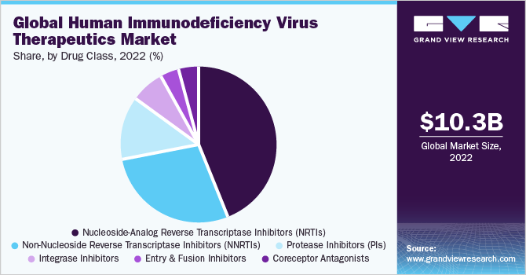
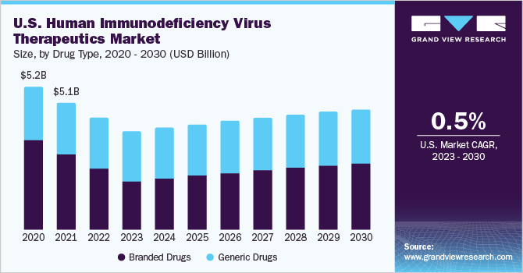
Backup- HIV Market
43.8%
1.5% CAGR
Baseline year: 2022
Notes:
https://www.grandviewresearch.com/industry-analysis/human-immunodeficiency-virus-hiv-1-therapeutics-market
Of these classes, the non-nucleoside reverse transcriptase inhibitors segment is expected to advance at the fastest CAGR of 3.6% over the forecast period.

Slide 33
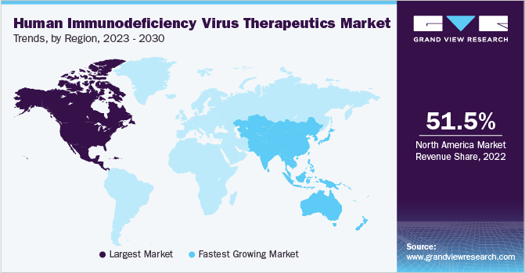
Backup- HIV Market
North America dominates the revenue share due to high treatment expense, increasing disease prevalence, and introduction of drugs with improved efficacy.
Asia Pacific expected to expand at the fastest CAGR of 4.8% over the forecast period from 2023 to 2030.
Baseline year: 2022

Slide 34
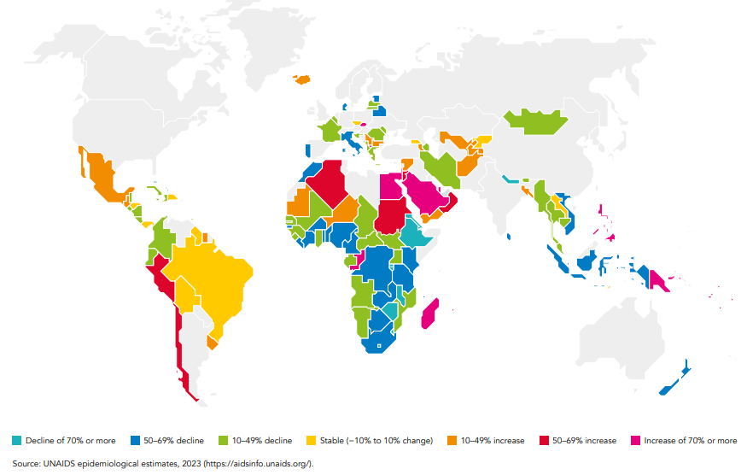
Backup - HIV Epidemiology UNAIDS Global Aids Update 2023
Notes:
https://www.unaids.org/sites/default/files/media_asset/2023-unaids-global-aids-update_en.pdf

Slide 35
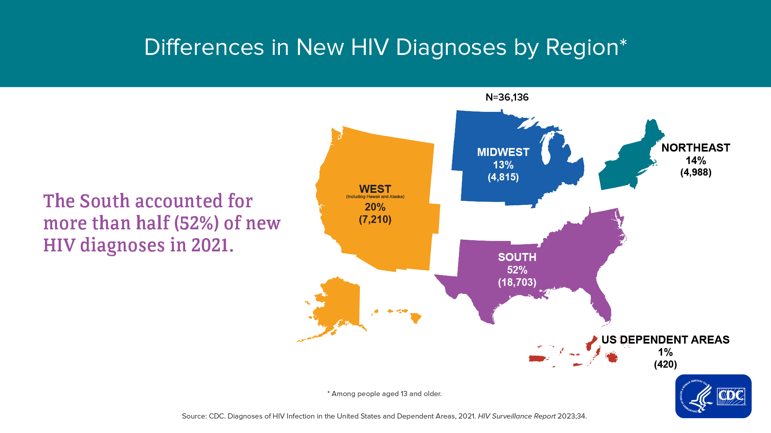
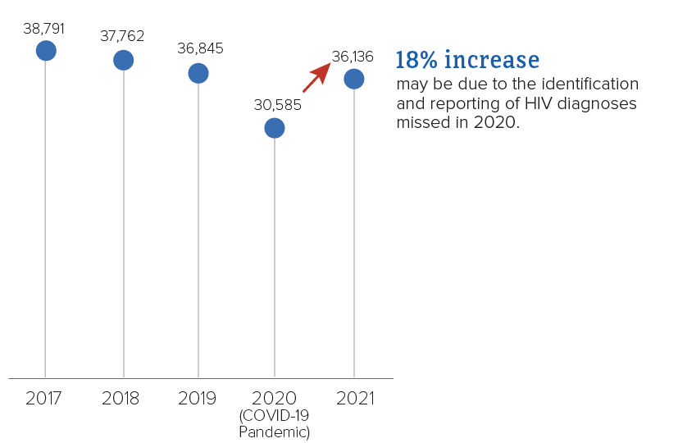
Notes:
https://www.cdc.gov/hiv/library/reports/hiv-surveillance/vol-34/index.html

Slide 36
References (Backup)
BCC Publishing January 2022 PHM061E Global Markets for Infectious disease Treatments
BCC Publishing July 2020 PHM232A Pandemic Outbreaks in the Past Decade: A BCC Research Overview
Grand View Research. (2023.). Human Immunodeficiency Virus Therapeutics Market Size, Share & Trends Analysis Report By Drug Type, By Drug Class (Entry & Fusion Inhibitors, Protease Inhibitors, Integrase Inhibitors), By Region, And Segment Forecasts, 2023 - 2030. Grand View Research. https://www.grandviewresearch.com/industry-analysis/human-immunodeficiency-virus-hiv-1-therapeutics-market
Mody, A., Sohn, A. H., Iwuji, C., Tan, R. K. J., Venter, F., &amp; Geng, E. H. (2023). HIV epidemiology, prevention, treatment, and implementation strategies for public health. <i>The Lancet</i>, <i>403</i>(10425), 21. https://doi.org/10.1016/S0140-6736(23)01381-8
UNAIDS. (2023). <i>The Path That Ends: 2023 UNAIDS Global Aids Update</i>. UNAIDS. https://www.unaids.org/sites/default/files/media_asset/2023-unaids-global-aids-update_en.pdf
CDC. (2021). <i>Diagnoses of HIV Infection in the United States and Dependent Areas, 2021</i>. Centers for Disease Control and Prevention. https://www.cdc.gov/hiv/library/reports/hiv-surveillance/vol-34/index.html

Slide 37


